Slide 1
Collaborative Platform Version 5.0
Team Members
Product Owner
Adrian Alfonso
Juan Caraballo
Jorge Travieso

Slide 2
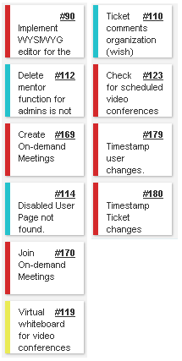
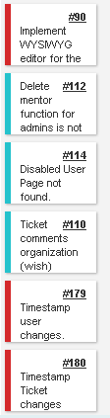
Sprint 2 Stories
My Sprint 2 Stories
Total 66 pts
Total 30 pts

Slide 3
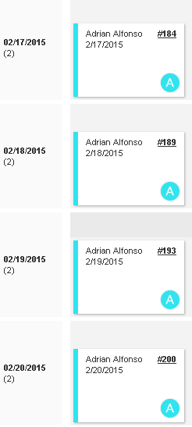
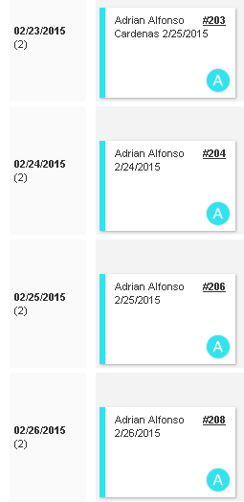
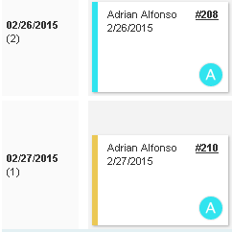
Daily Scrums

Slide 4
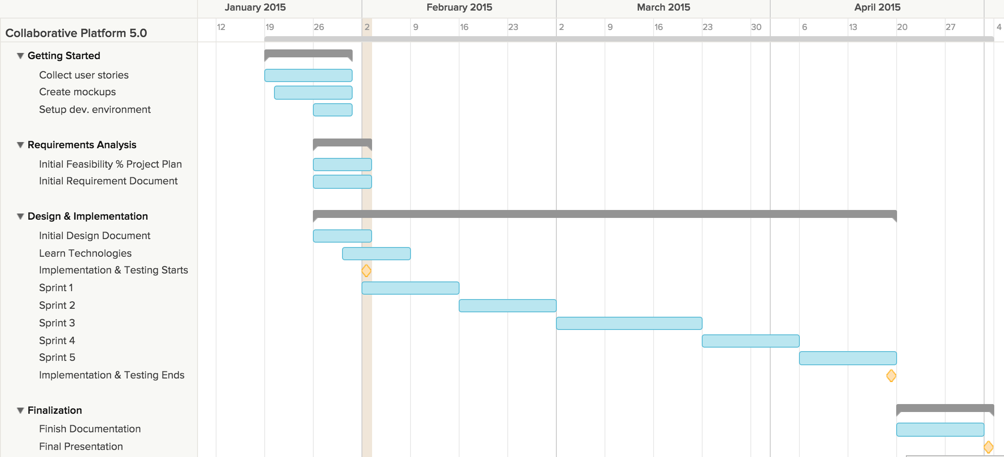
Project plan

Slide 5
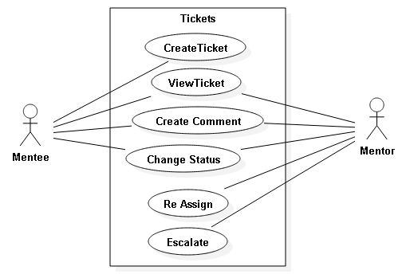
Use Cases Modified

Slide 6
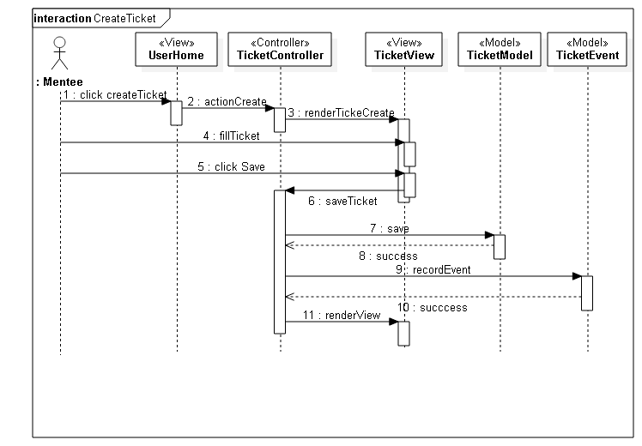
Sequence Diagram (Create Ticket)

Slide 7
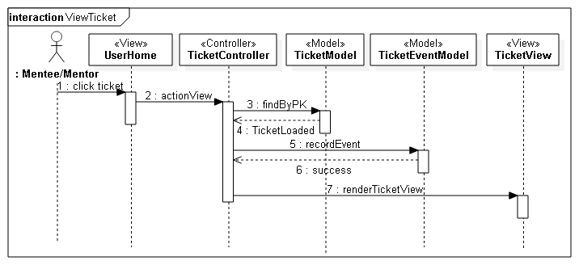
Sequence Diagram (View Ticket)

Slide 8
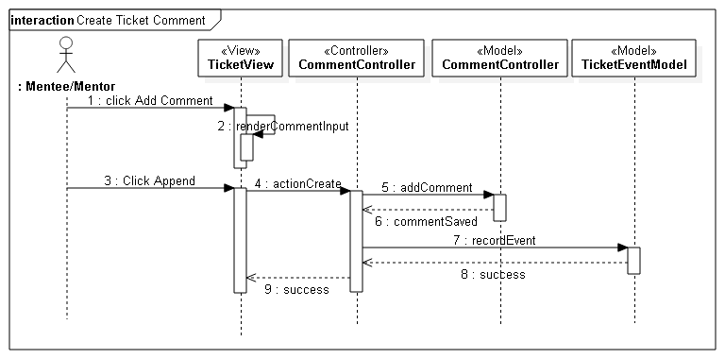
Sequence Diagram (Create Comment)

Slide 9
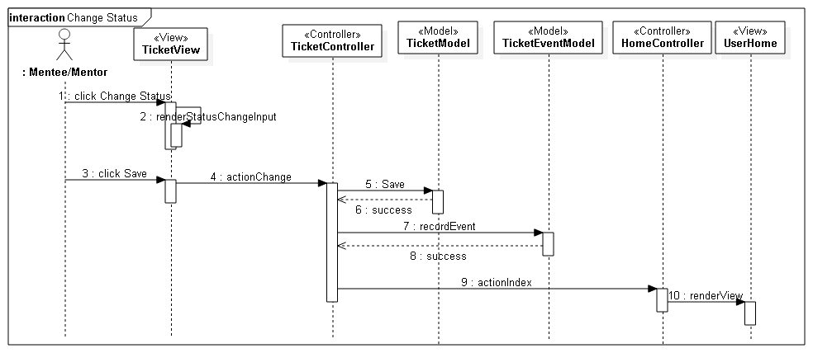
Sequence Diagram (Change Status)

Slide 10
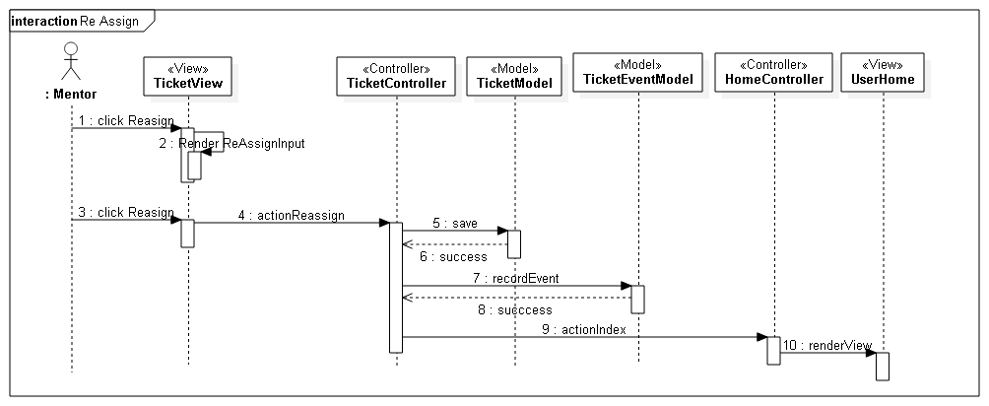
Sequence Diagram (Re Assign)

Slide 11
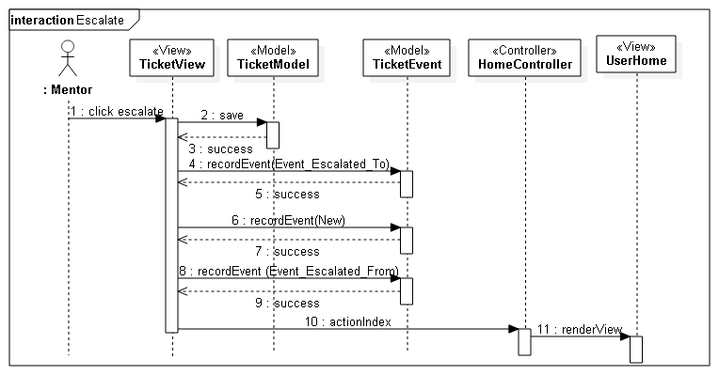
Sequence Diagram (Escalate)

Slide 12
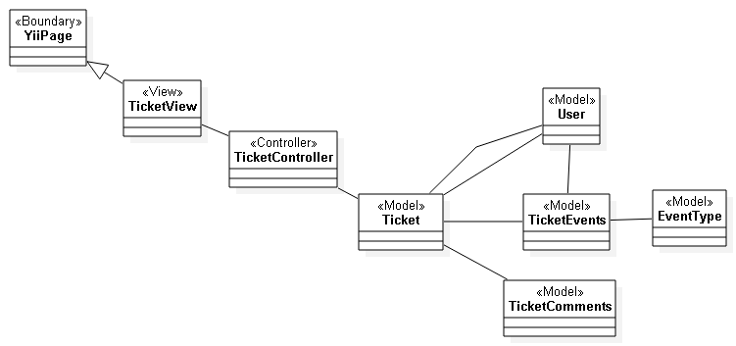
Class Diagram (Ticket Events)

Slide 13
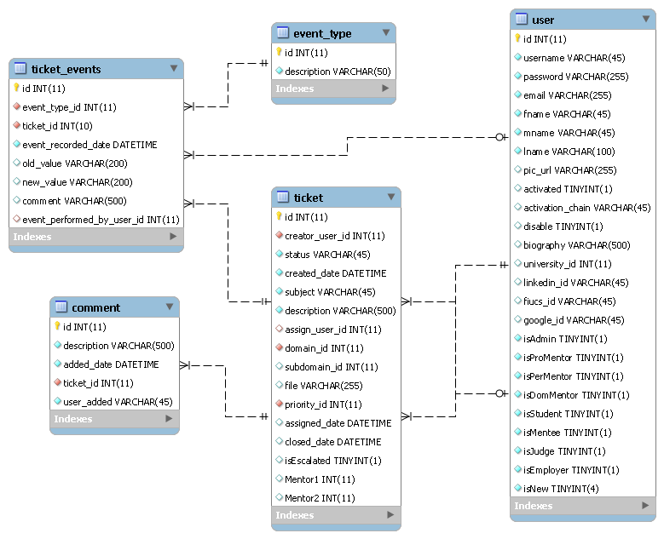
ER Diagram

